Slide 1
Neural Network [2-1]
Joohyung Lee

Slide 2
Scope
So far…
Mathematical representation of NN
Good potential that NN possesses
Biological inspiration
Then,,, how do I make its potential real?
Cast the problem into (parameter) optimization problem
Exploitation from ML
SGD
Loss function
Loss function Gradient

Slide 3
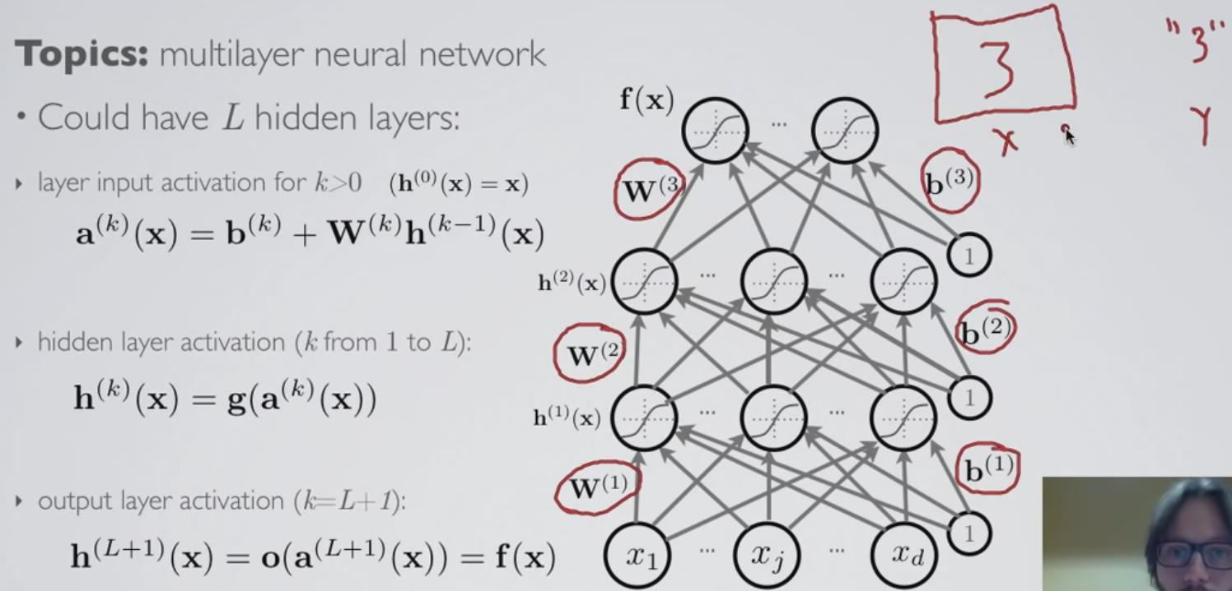
Problem
Mathematical expression and the meaning of multi-layer NN
There are many parameters: weights(connections b/w neurons) and bias at layers
We need to find and assign an optimal values for those parameters to induce good behavior
We will ‘train’ a NN to let it solves the problem (supervised classification problem)!!

Slide 4
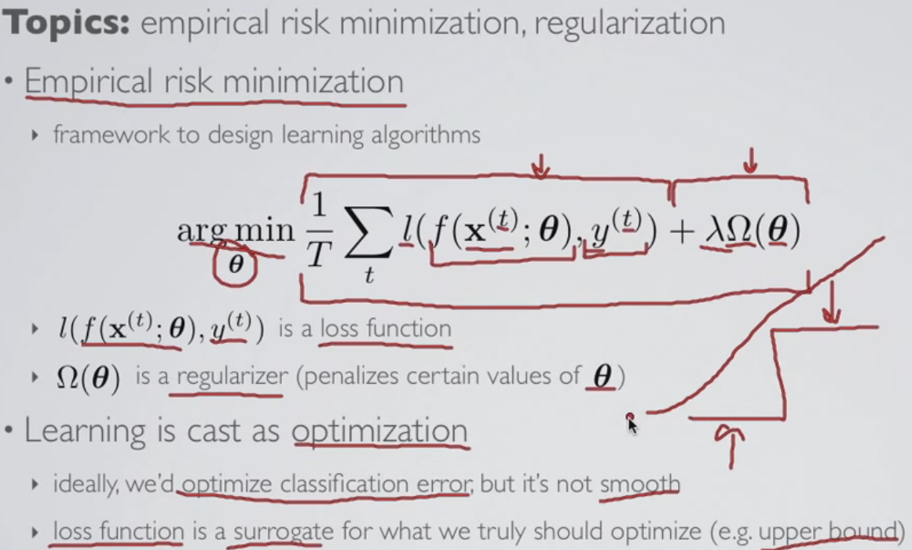
Approach
‘Empirical risk minimization’ or ‘Structural risk minimization’ in the field of Machine Learning
Likelihood part: loss function that compares b/w the output of NN and the expected label-correct answer
A-priori part (regularizer): penalizes certain set of parameters that degrades the performance for the NEW images (boost generalization)
Λ: hyper-parameter which controls the balance b/w opt avg loss and opt reg
Argmin(‘objective’) casts the problem into optimization problem
Classification error shall be our objective function but is not smooth
Surrogate function that is smooth version of classification error function

Slide 5
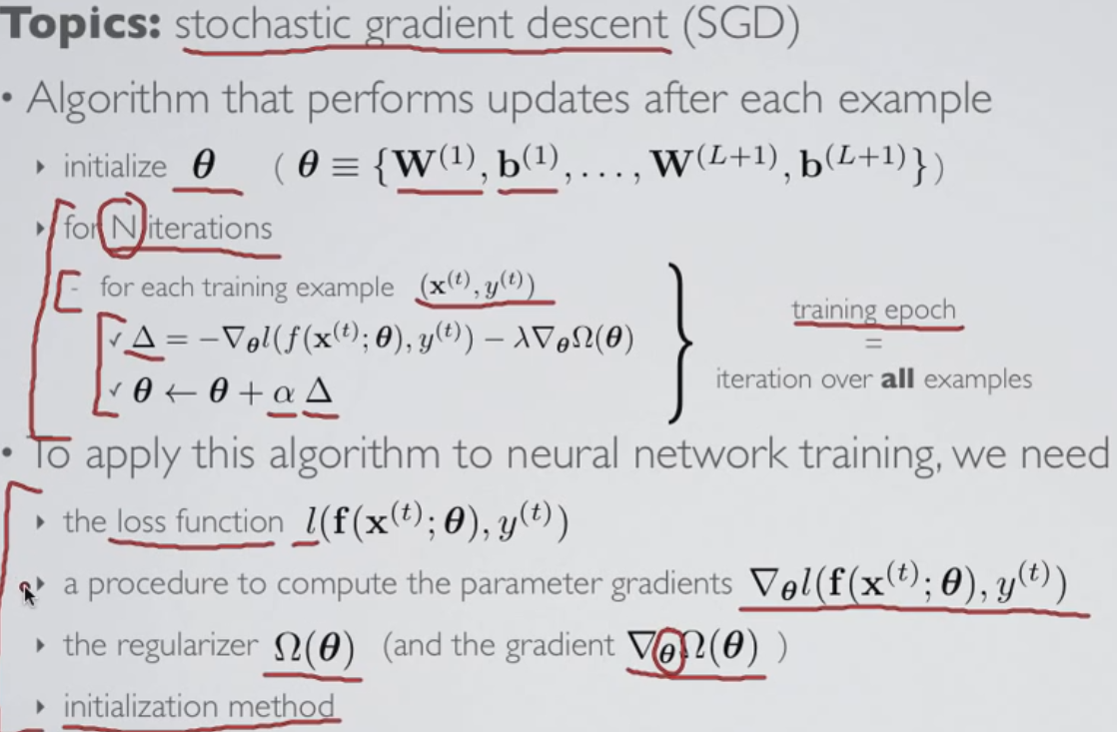
Optimization algorithm: SGD
1. initialize all the parameters
2. iterate through training set which(data&label pair-supervised learning) will give the gradient for the parameter, and the update direction will be the opposite of the gradient of the loss function plus the gradient of regularizer since it represents the direction which will incur the largest decrement of the loss function: largest likelihood and a-priori
What need to be determined?
Loss function
Parameter update algorithm
Regularizer format
Parameter initialization

Slide 6
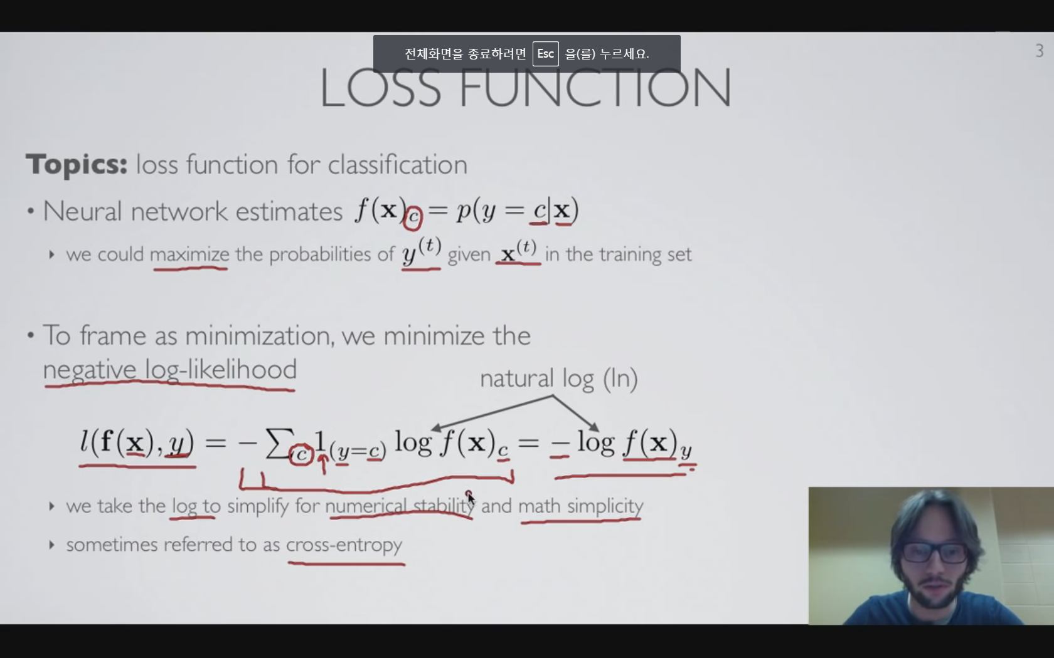
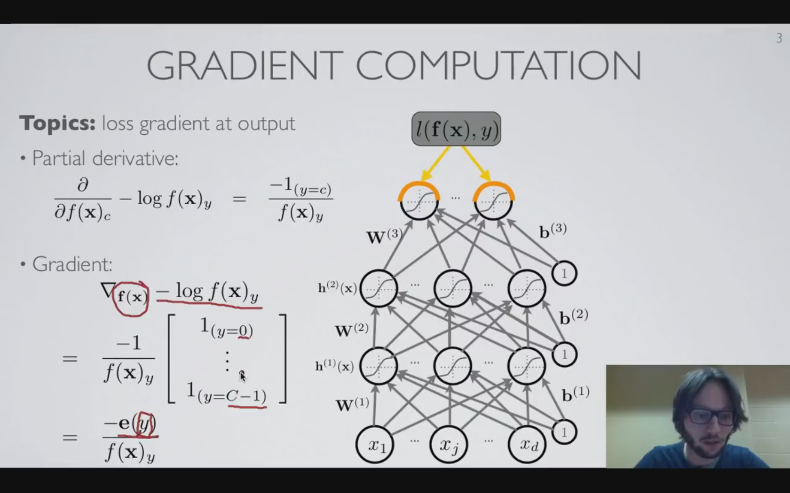
LOSS FUNCTION
Interpretation of the output of a NN as a conditional probability distribution
Cast the maximization problem into minimization problem using negative log-likelihood
Gradient of loss function
@by cross-entropy
@by pre-activation
@by hidden layer

Slide 7
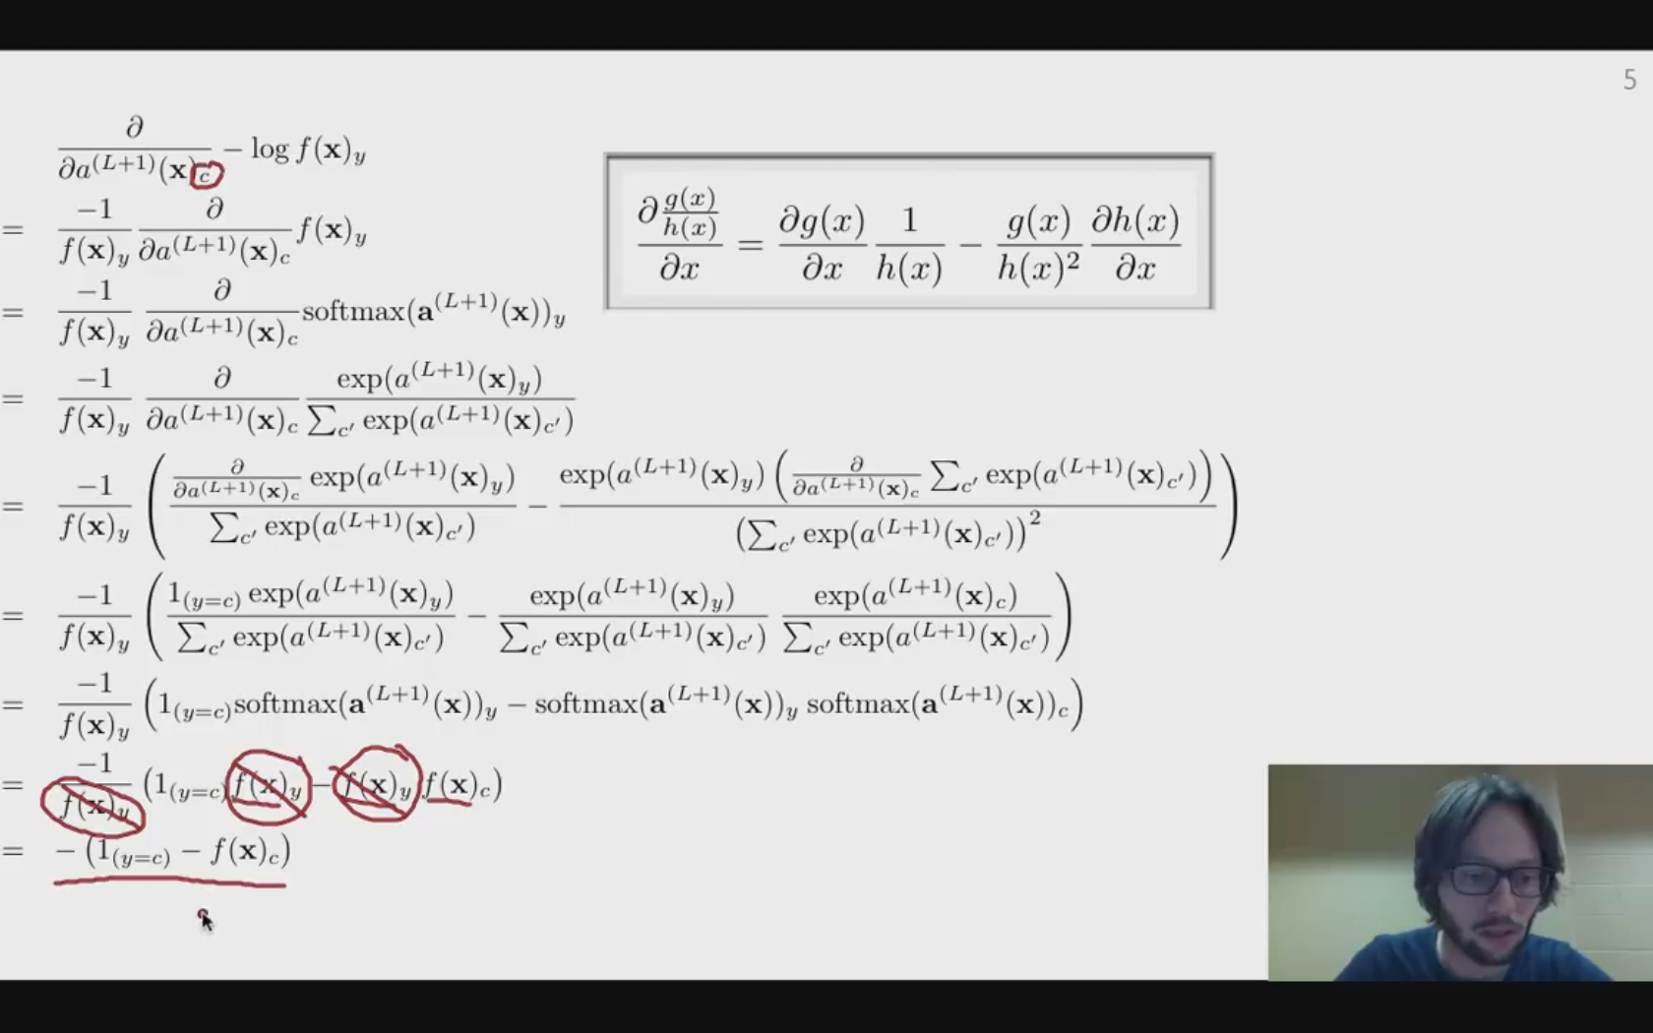
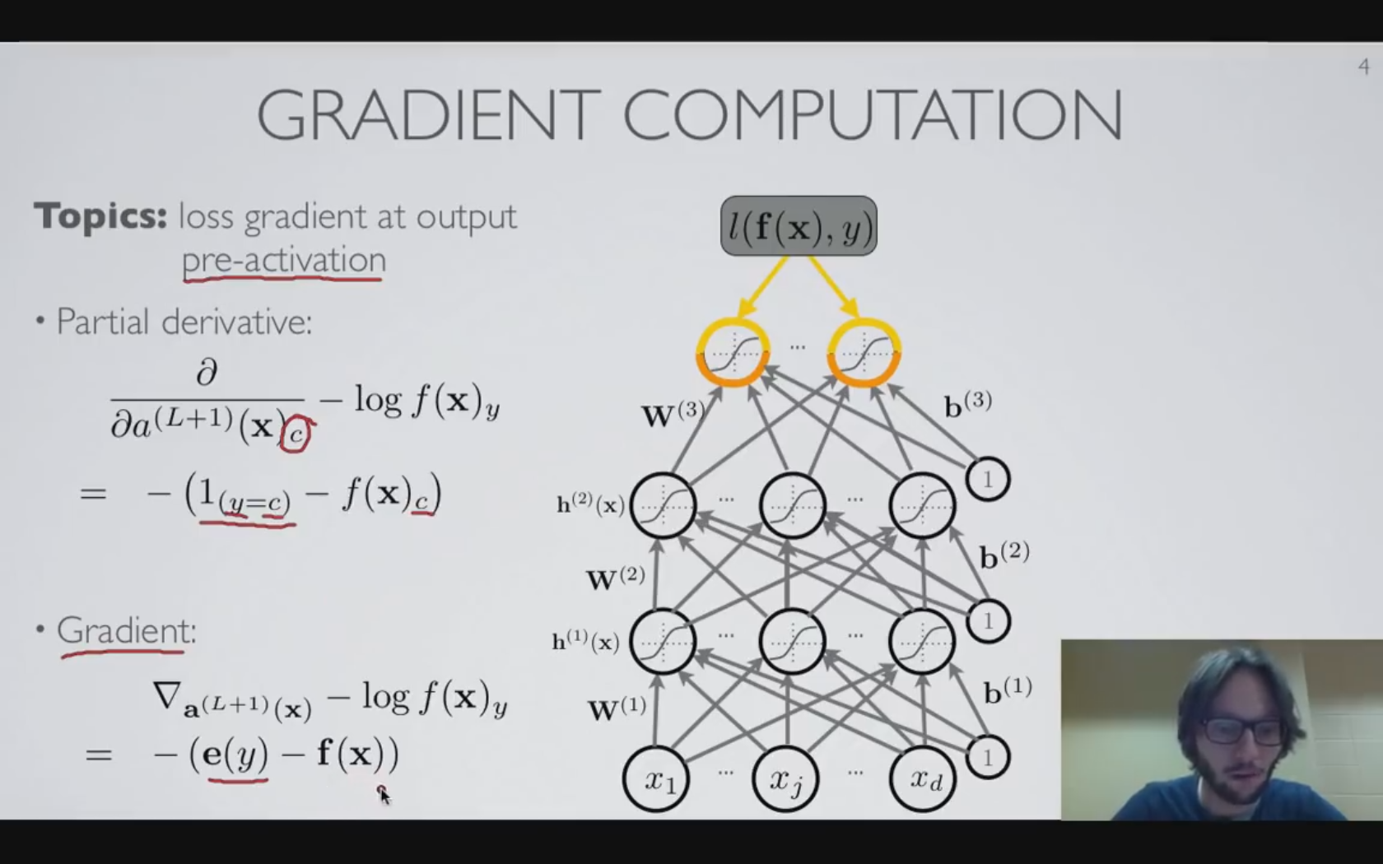
Loss function gradient -by pre-activation at the last layer

Slide 8
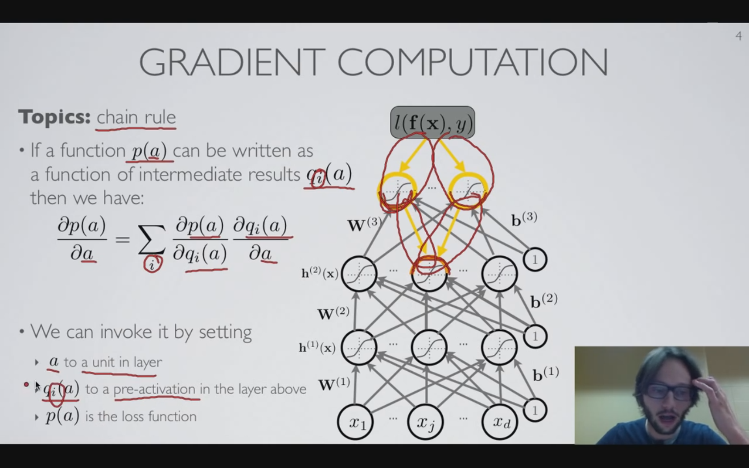
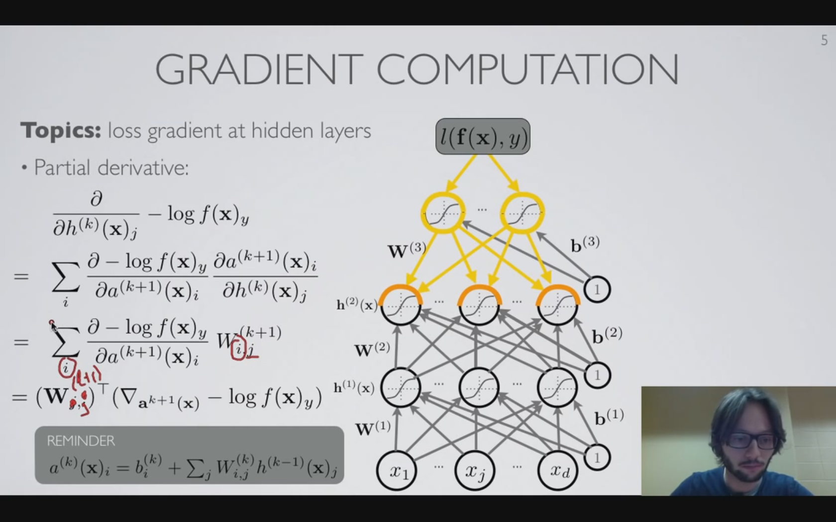
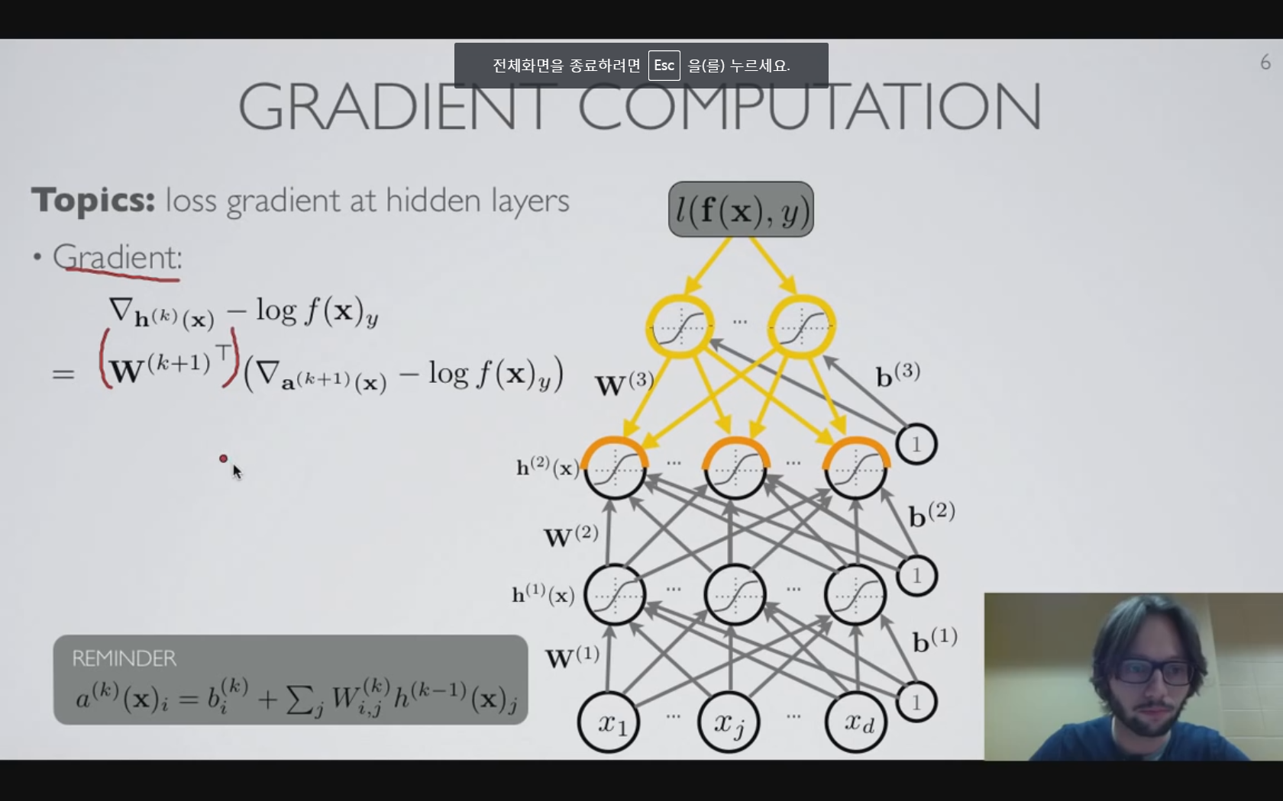
Loss function gradient -General formula for gradient at hidden layers

Slide 9
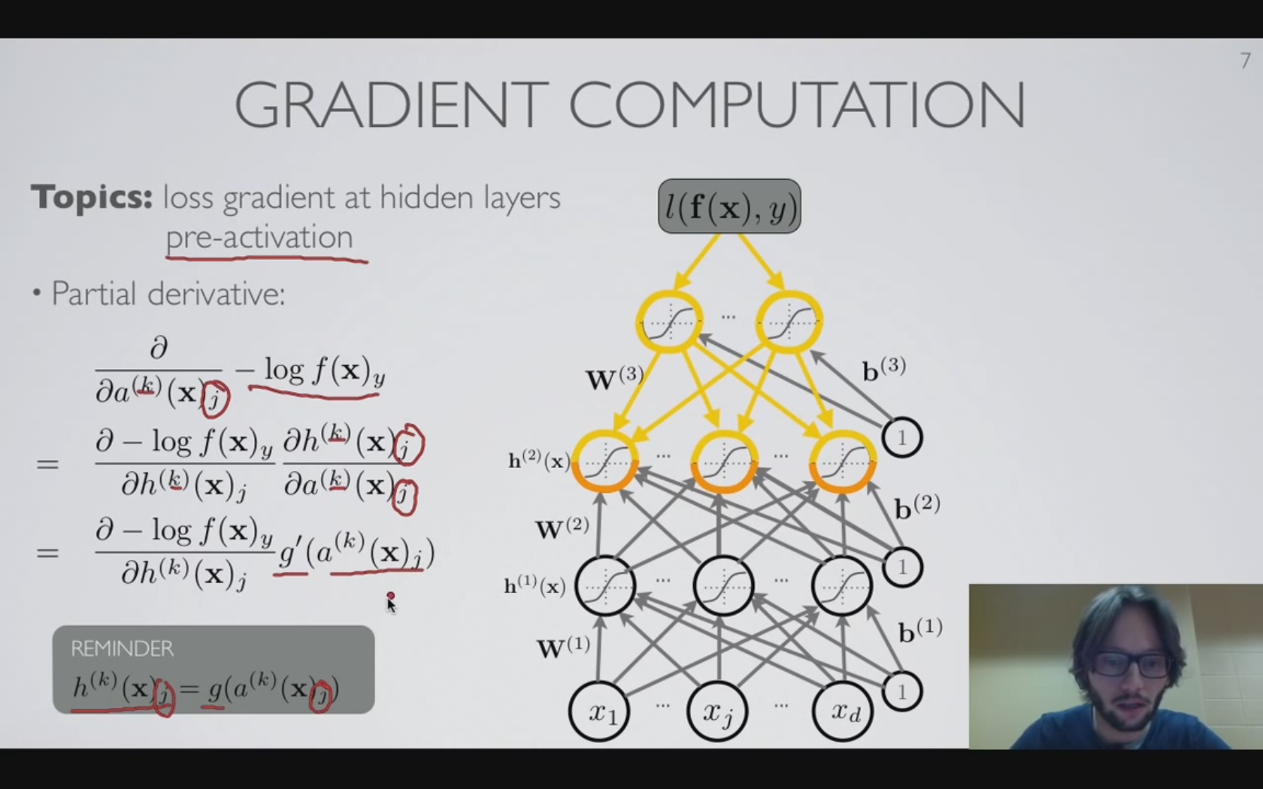

Loss function gradient -General formula for gradient at hidden layers pre-activation
Notes:
Jacobian

Slide 10
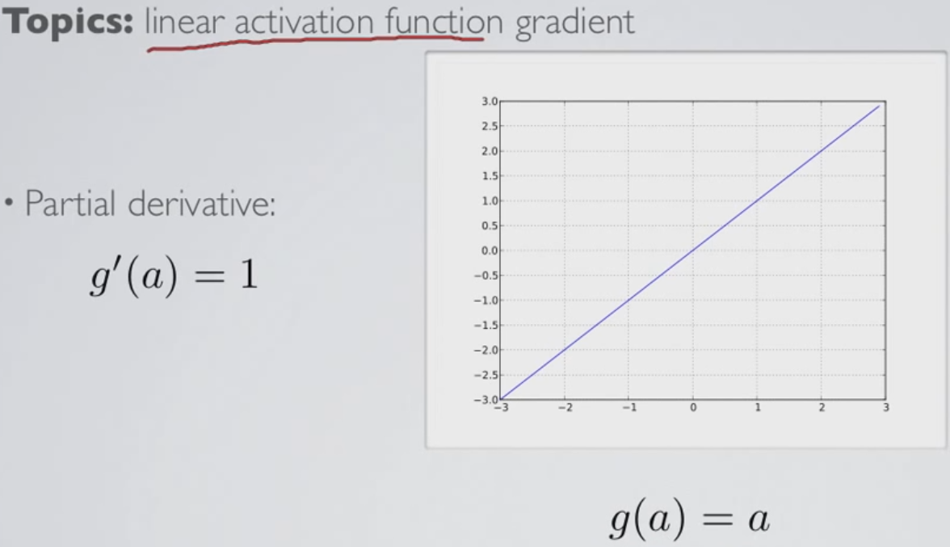
Loss function gradient -Gradient for various activation function 1

Slide 11
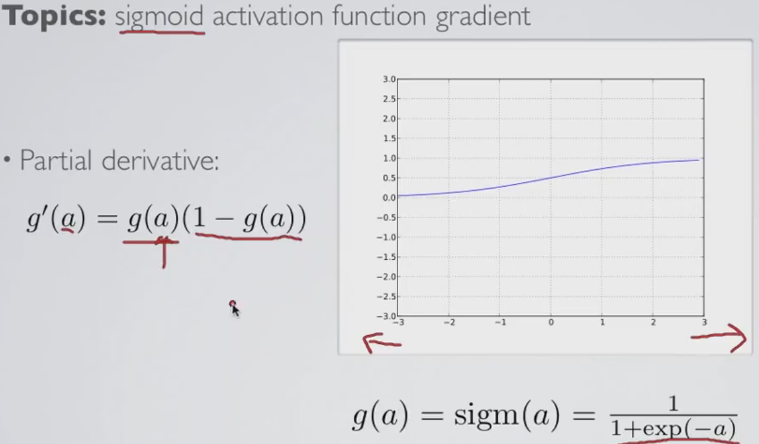
Loss function gradient -Gradient for various activation function 2

Slide 12
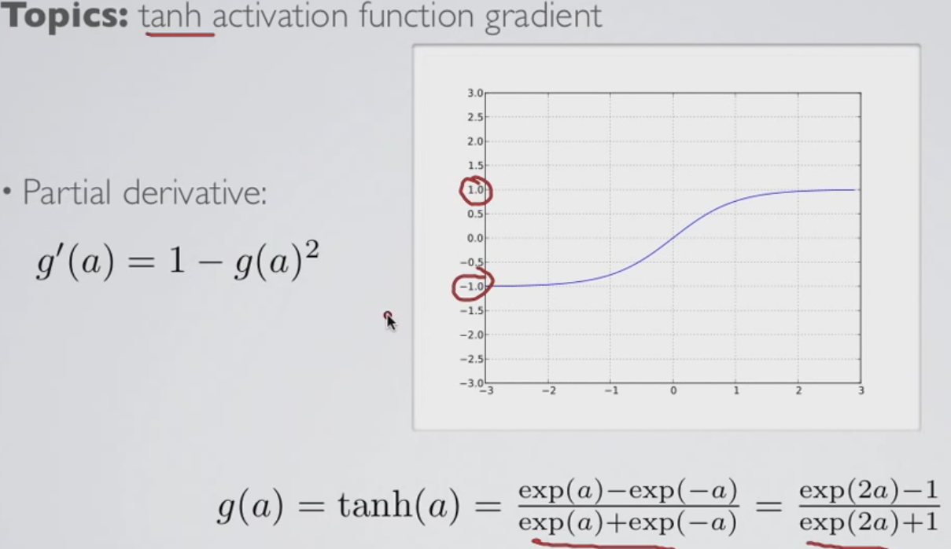
Loss function gradient -Gradient for various activation function 3

Slide 13
References
From “Neural Networks” by Hugo Larochelle. Lec 2.1~2.5
https://www.youtube.com/user/hugolarochelle

